Slide 1
Blockchain Development Course
Tutor: Loui Mercieca
Date: May 2018

Slide 2
Course Material
Module 1
Intro to Blockchain
Into to Etherum & Smart Contracts
Cryptogrpahy
Demo

Slide 3
Lesson 1 - Intro to Blockchain
Problem in a network is that each machine has its own state
Blockchain is a mixture of network and a database
If one thing changes in one place it changes everywhere
It’s a book of transactions (blocks) and its append only
That is why the blockchain is deterministic
The current value of a wallet is starting 0 plus all transactions that are in/out. Therefore we need to be fully synched to work with them.
© 2018 Loui Mercieca. All rights reserved

Slide 4
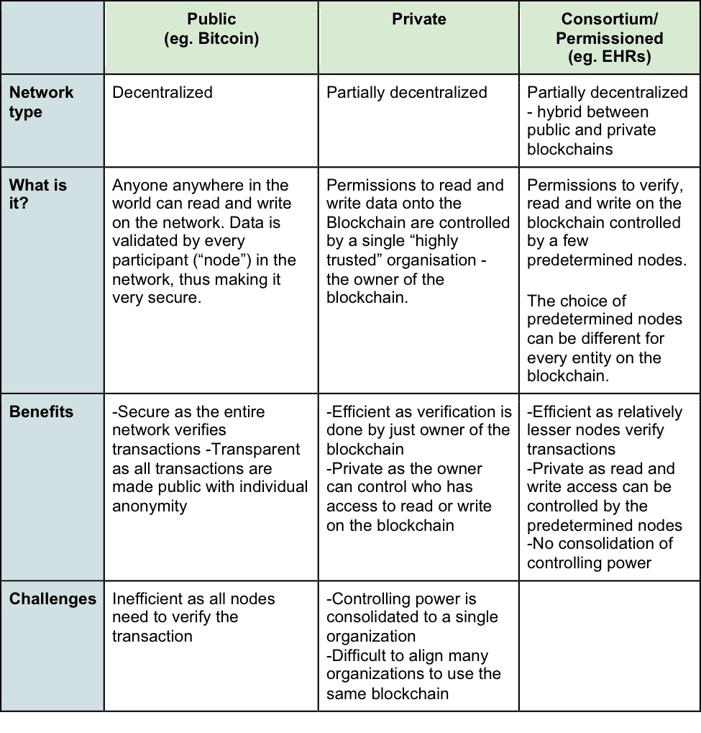
Lesson 1 - Intro to Blockchain
© 2018 Loui Mercieca. All rights reserved

Slide 5
Lesson 1 - Intro to Ethereum & Smart Contracts
Ethereum adds a virtual machine that can execute code.
In each transaction data can be added, which can be a code that performs logic (smart contracts) as well as input/output to functions that change the state.
The main role of smart contracts is to update the state of the blockchain. This logic is known as smart contracts and that is what we code.
Therefore programs are immutable, they never change.
© 2018 Loui Mercieca. All rights reserved

Slide 6
Lesson 1 - Intro to Ethereum & Smart Contracts
Note that "contracts" in Ethereum should not be seen as something that should be "fulfilled" or "complied with"; rather, they are more like "autonomous agents" that live inside of the Ethereum execution environment, always executing a specific piece of code when "poked" by a message or transaction, and having direct control over their own ether balance and their own key/value store to keep track of persistent variables.
© 2018 Loui Mercieca. All rights reserved

Slide 7
Lesson 1 - Intro to Ethereum & Smart Contracts
Ethereum Accounts
In Ethereum, the state is made up of objects called "accounts", with each account having a 20-byte address and state transitions being direct transfers of value and information between accounts.
An Ethereum account contains four fields:
The nonce, a counter used to make sure each transaction can only be processed once
The account's current ether balance
The account's contract code, if present
The account's storage (empty by default)
© 2018 Loui Mercieca. All rights reserved

Slide 8
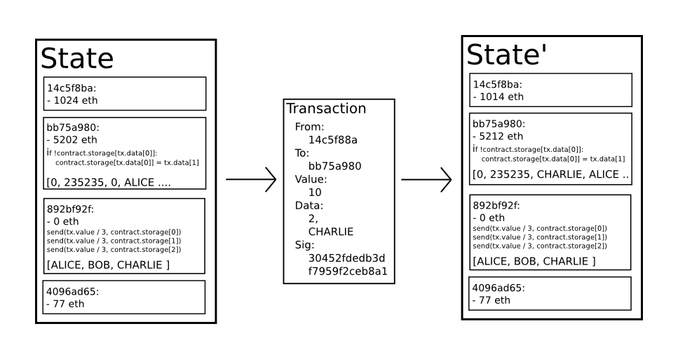
Lesson 1 - Intro to Ethereum & Smart Contracts
Ethereum Accounts - State Transactions
© 2018 Loui Mercieca. All rights reserved

Slide 9
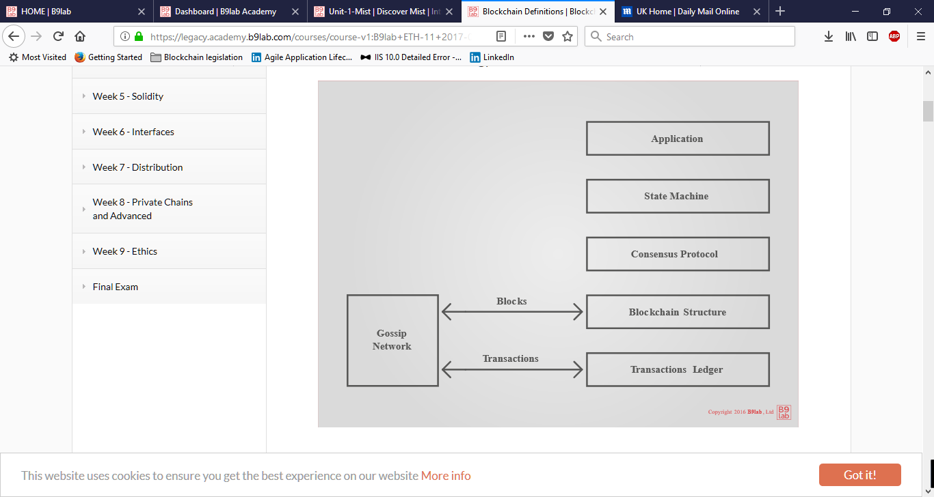
Lesson 1 - Intro to Ethereum & Smart Contracts
A transaction is an atomic event, an event whose sub-event parts make no sense in isolation.
© 2018 Loui Mercieca. All rights reserved

Slide 10
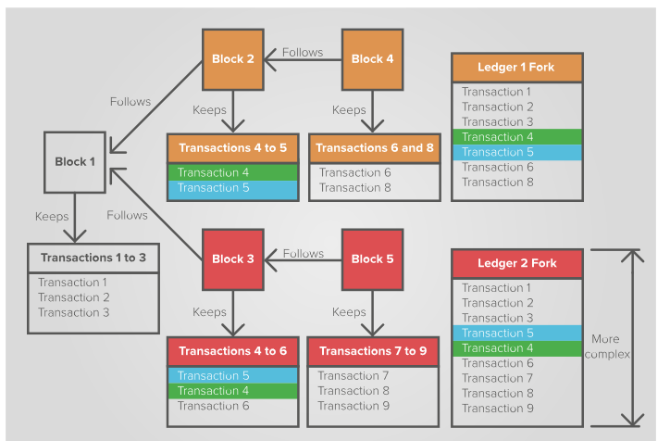
Lesson 1 - Intro to Ethereum & Smart Contracts
Forking
© 2018 Loui Mercieca. All rights reserved

Slide 11
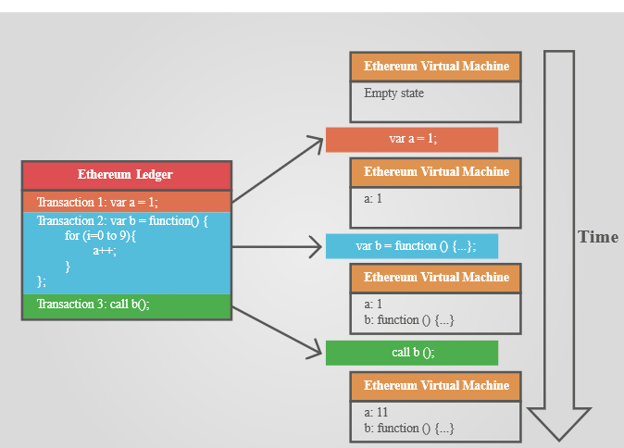
Lesson 1 - Intro to Ethereum & Smart Contracts
Forking
© 2018 Loui Mercieca. All rights reserved

Slide 12
Lesson 1 - Intro to Ethereum & Smart Contracts
Further Reading
https://github.com/ethereum/wiki/wiki/White-Paper
http://gavwood.com/Paper.pdf
© 2018 Loui Mercieca. All rights reserved

Slide 13
Lesson 1 - Cryptography
Encrypt and decrypt
Alice wants to send a message to Bob, and for Bob's eyes only:
Bob gives Alice his public key
Alice uses Bob's public key to encrypt the message
Alice sends Bob the encrypted message
Bob decrypts the message with his private key
Sign and verify
Alice wants to make sure that Bob's public announcement is indeed from Bob:
Bob gives Alice his public key
Bob signs his announcement with his private key
Bob sends Alice his announcement and its signature
Alice verifies the signature with Bob's public key
© 2018 Loui Mercieca. All rights reserved

Slide 14
Lesson 1 - Cryptography
Ethereum uses Elliptic curve as its basis to sign and verify
http://mathworld.wolfram.com/EllipticCurve.html
https://anders.com/blockchain/public-private-keys/keys.html
© 2018 Loui Mercieca. All rights reserved

Slide 15
Lesson 1 - Cryptography
Mix and Match
It is possible to mix both ideas,
whereby Alice encrypts her message with Bob's public key, then signs the encrypt file with her private key.
Upon reception, Bob verifies the signature with Alice's public key, then decrypts the file with his private key.
© 2018 Loui Mercieca. All rights reserved

Slide 16
Lesson 1 - Cryptography
Key management, PKI
If you look again at the Alice and Bob examples, you will notice that there is a vulnerability in "Bob gives Alice his public key".
A malicious Charlie could intercept Bob's public key and pass on his own public key to Alice.
Because of this, key management and public key infrastructure (PKI) is an important part of cryptography.
© 2018 Loui Mercieca. All rights reserved

Slide 17
Lesson 1 - Cryptography
Cryptographic Hash Functions
Such a hash function:
converts an input, a.k.a. the message, into an output, a.k.a the hash
does the conversion in a reasonable amount of time
is such that it is practically impossible to re-generate the message out of the hash
is such that the tiniest change in the message, changes the hash beyond recognition
is such that it is practically impossible to find 2 different messages with the same hash
.
© 2018 Loui Mercieca. All rights reserved

Slide 18
Lesson 1 - Cryptography
Cryptographic Hash Functions
With such a function, you can:
prove that you have a message without disclosing the content of the message, for instance:
to prove you know your password
to prove you previously wrote a message
rest assured the message was not altered
index your messages
.
© 2018 Loui Mercieca. All rights reserved

Slide 19
Lesson 1 - Cryptography
Cryptographic Hash Functions
Bitcoin uses SHA-256.
Ethereum uses Keccak-256 & Keccak-512.
© 2018 Loui Mercieca. All rights reserved

Slide 20
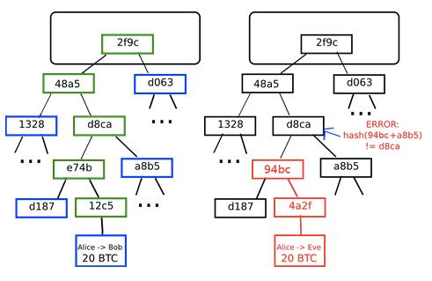
Lesson 1 - Cryptography
Merkle Tree
© 2018 Loui Mercieca. All rights reserved

Slide 21
Lesson 1 - Cryptography
Merkle Tree
A Merkle tree is a tree where:
each leaf node keeps a piece of the data.
the complete data is obtained by collating the leaf nodes in a depth-first search fashion.
each parent node keeps the computed hash of its children hashes.
With a Merkle tree, you can:
keep data behind a single hash, just like a single-pass hash function would offer over the whole content.
download and verify the integrity of data pieces as they come in random order.
In a blockchain environment, each block header keeps one or more hash(es) of the top leaf of one of more merkle tree(s).
© 2018 Loui Mercieca. All rights reserved

Slide 22
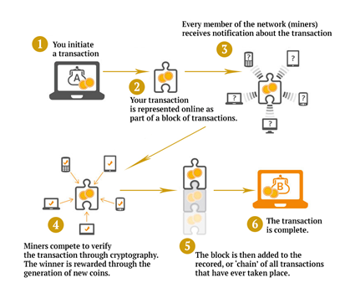
Lesson 1 - Cryptography
Mining
© 2018 Loui Mercieca. All rights reserved

Slide 23
Lesson 1 - Cryptography
Mining – Further Reading
https://anders.com/blockchain/hash.html
https://www.coinwarz.com/difficulty-charts/ethereum-difficulty-chart
© 2018 Loui Mercieca. All rights reserved

Slide 24
Lesson 1 - Cryptography
Gossip Protocol Network
In the same fashion as in human social networks, a computer gossip network works by having each individual node relay freshly received information to its own peers.
Such protocols vary in their aspects, such as latency or laziness.
Nodes may also choose to drop new information.
In a Bitcoin context, a new transaction is broadcast in this way if and only if it is valid.
© 2018 Loui Mercieca. All rights reserved

Slide 25
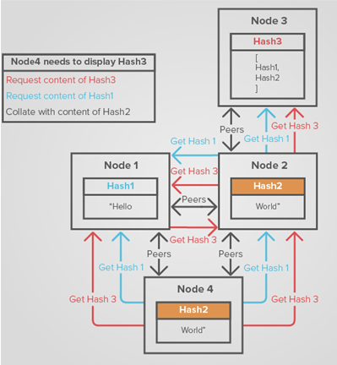
Lesson 1 - Cryptography
Gossip Protocol Network
In a gossip network a node randomly chooses to whom to broadcast and it does not wait for acknowledgements
© 2018 Loui Mercieca. All rights reserved

Slide 26
Lesson 1 - Cryptography
Gas
Ethereum transactions are code and may include an infinite loop or a circular reference that never breaks, all of which can be seen as another type of attack.
To protect against such an attack, Ethereum introduces another concept, that of gas.
Gas is convertible from Ether, the currency of the Ethereum blockchain, is provided by the transaction creator and is consumed at each computational step:
If the computation stops before all the gas is consumed, the consumed gas is collected by the winning miner, and the remainder returned to the transaction creator.
If the gas provided is fully consumed before the computations have completed, the computation stops, all state changes dropped, and all gas goes to the winning miner.
© 2018 Loui Mercieca. All rights reserved

